Slide 1

Alpoet: joining CLIP with chatGLM(P-Tuning) to write Chinese Ancient Poems Based On Images
Reporter: Huang Ziheng

Slide 2


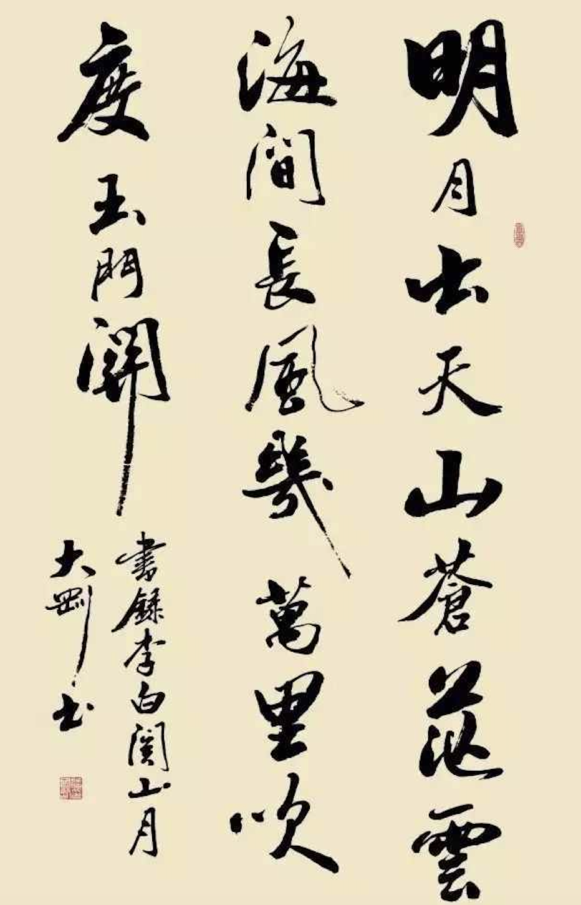
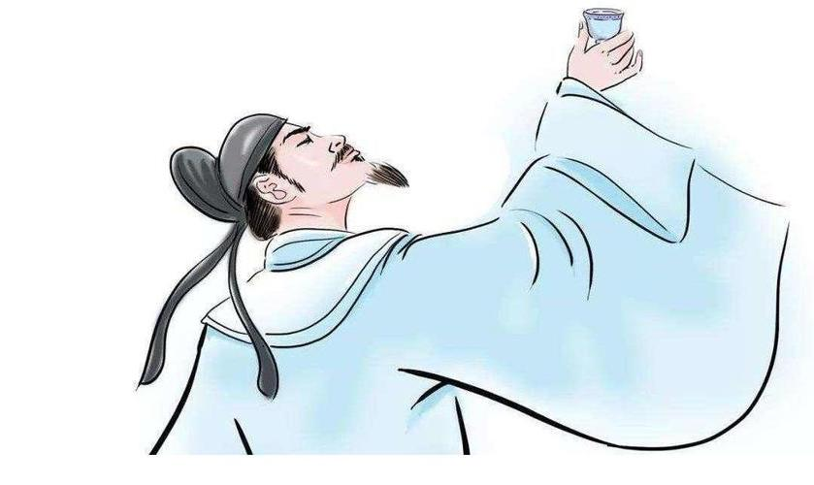
Alpoet
明月
云海 山

Slide 3
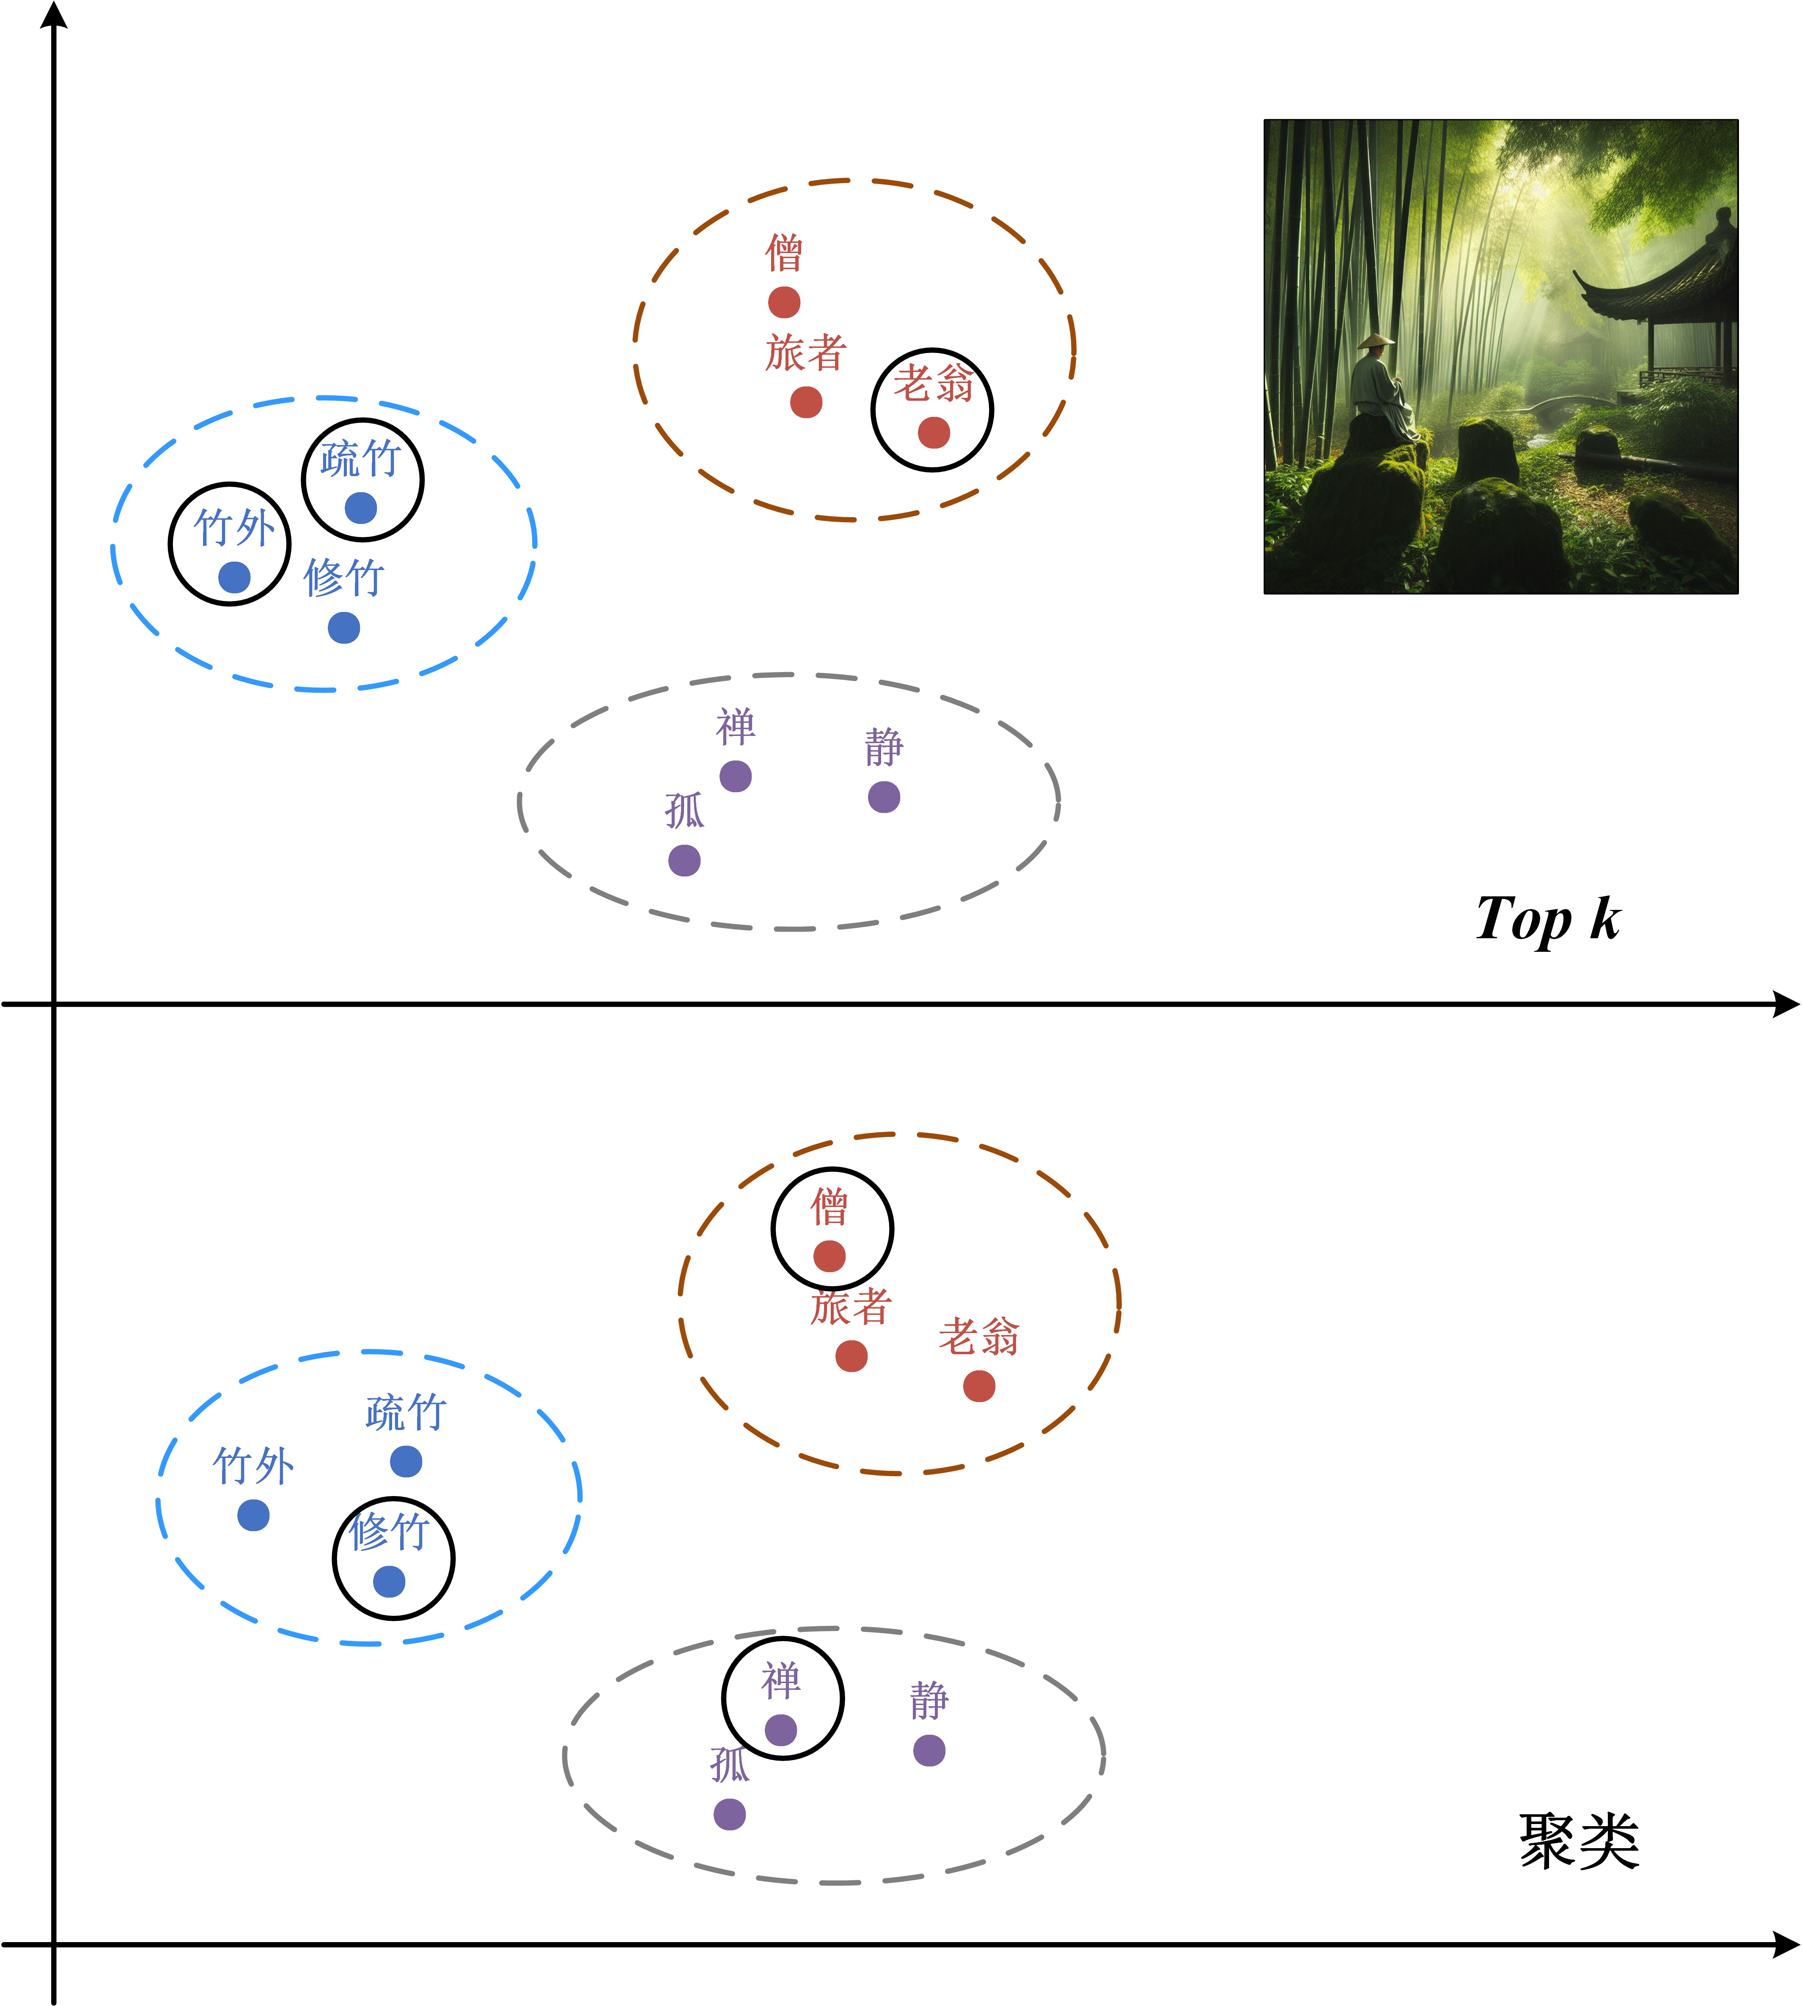
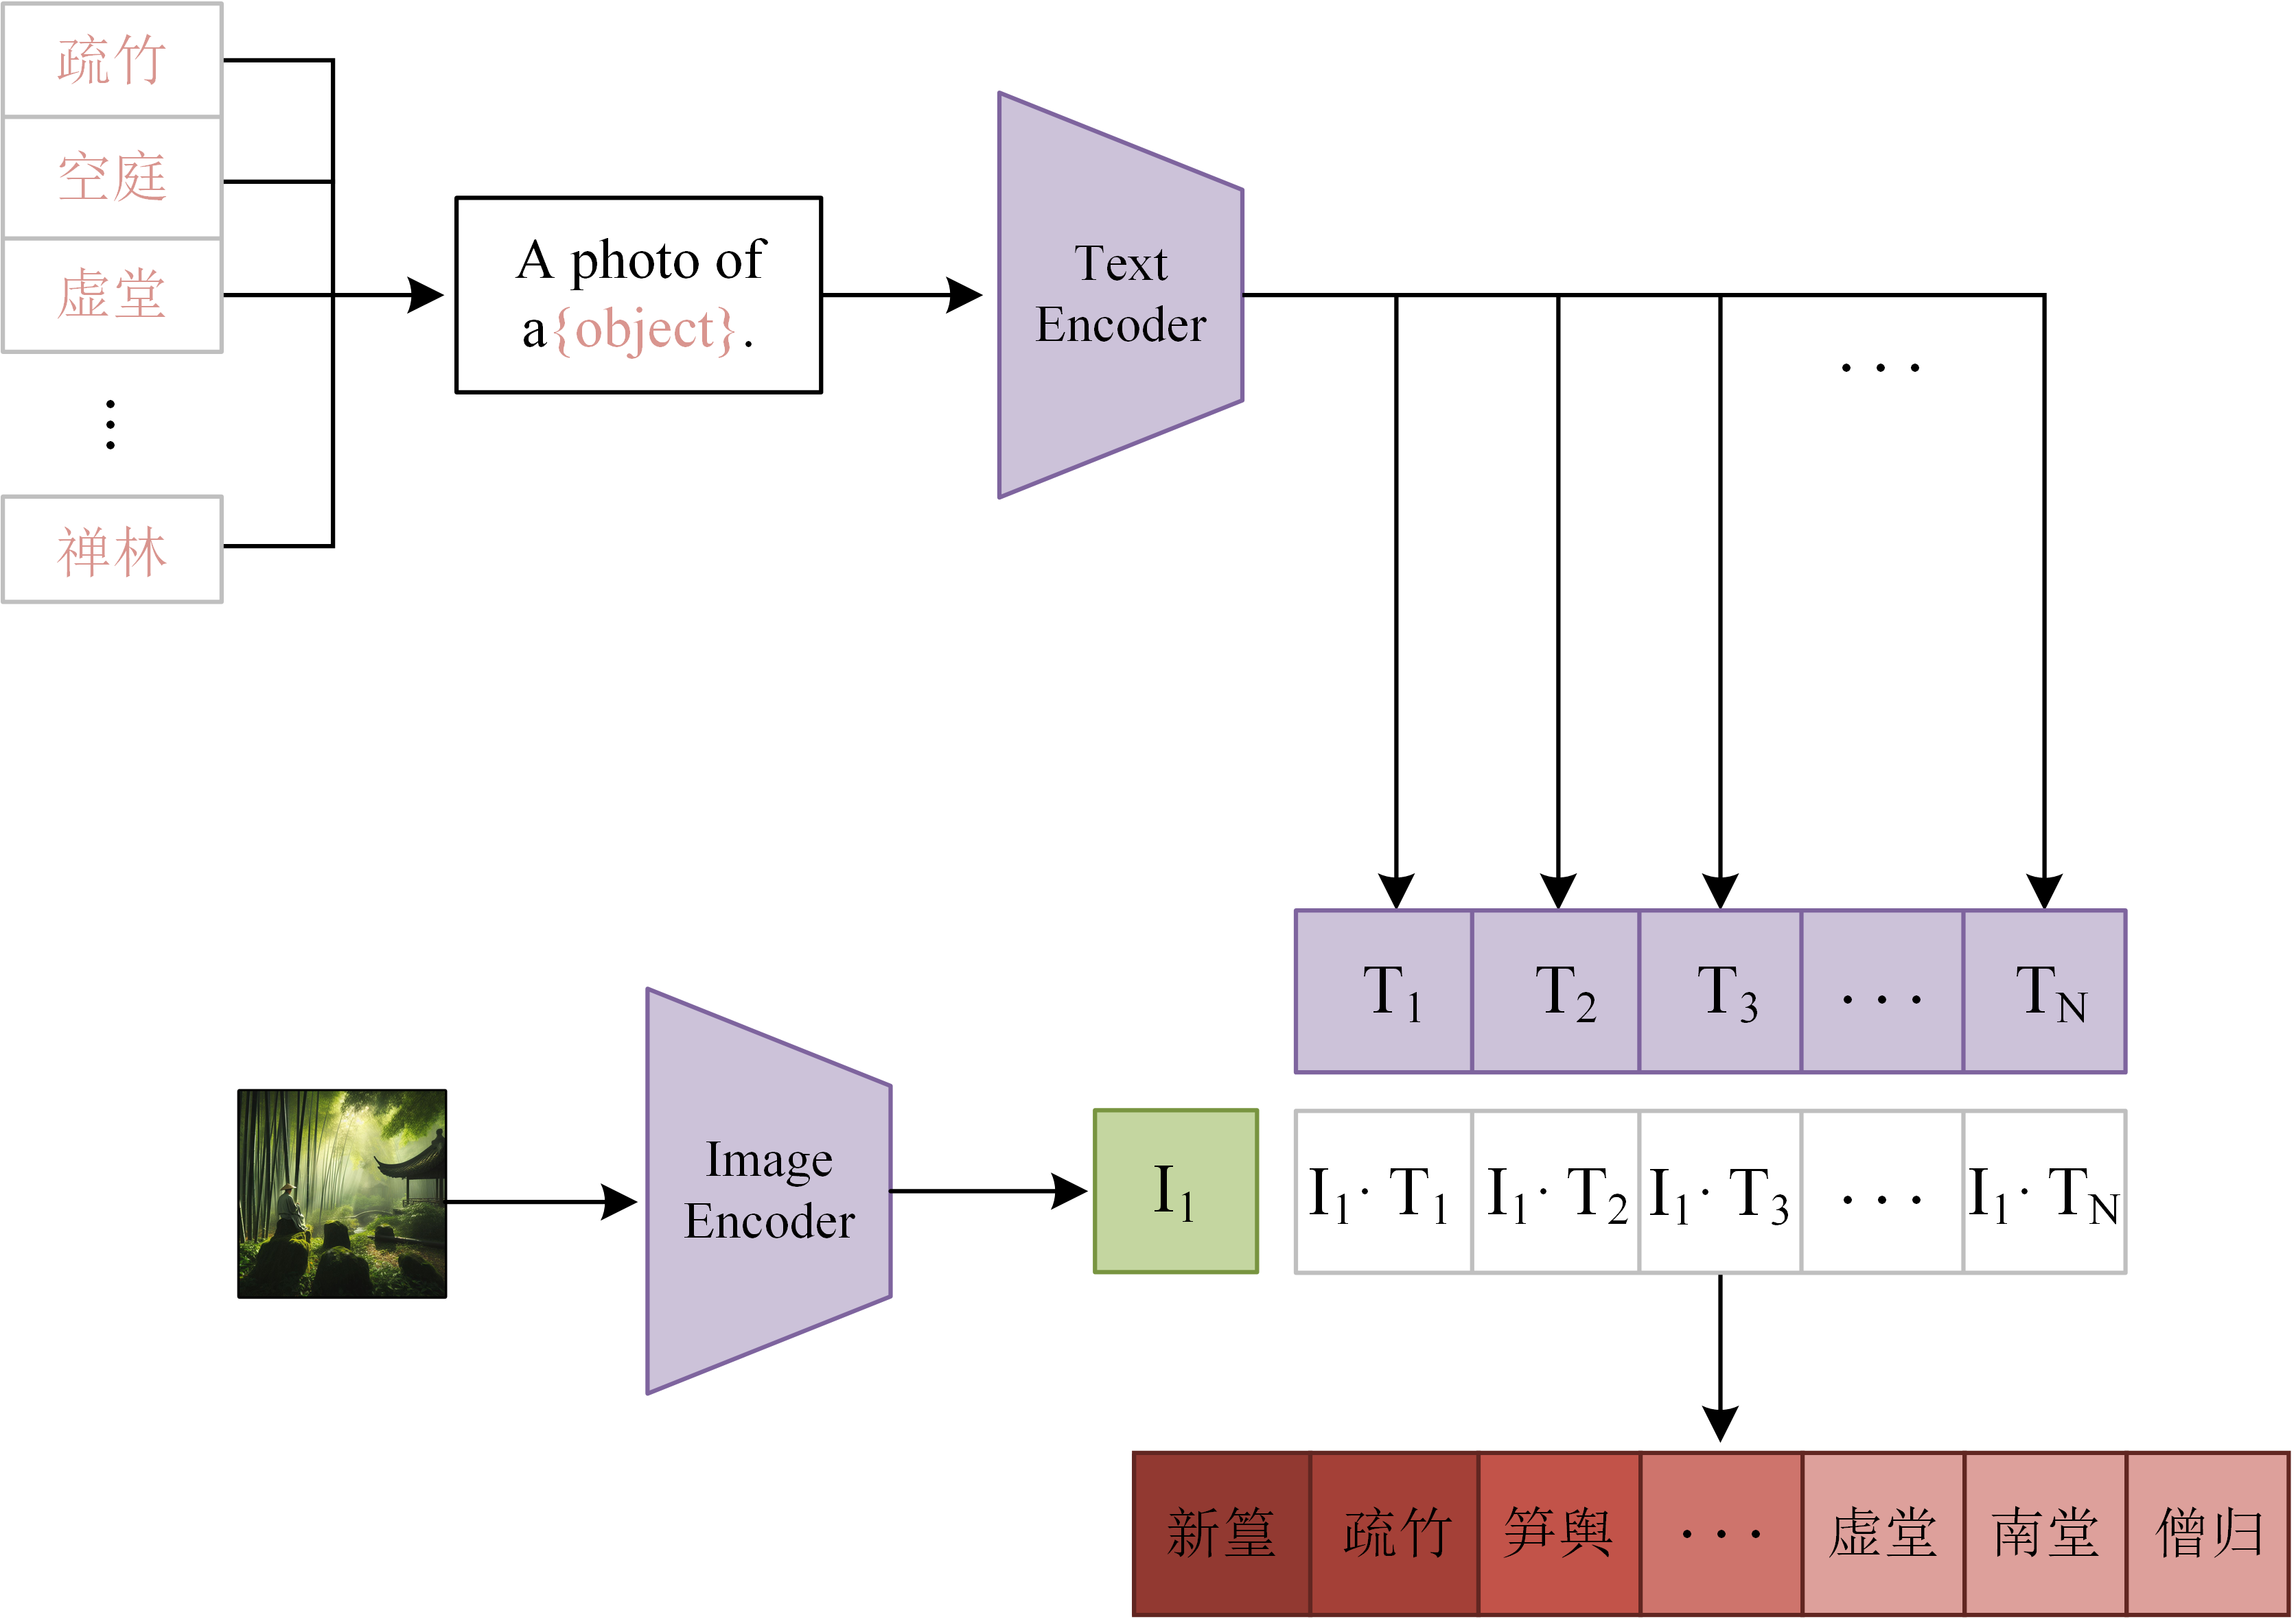
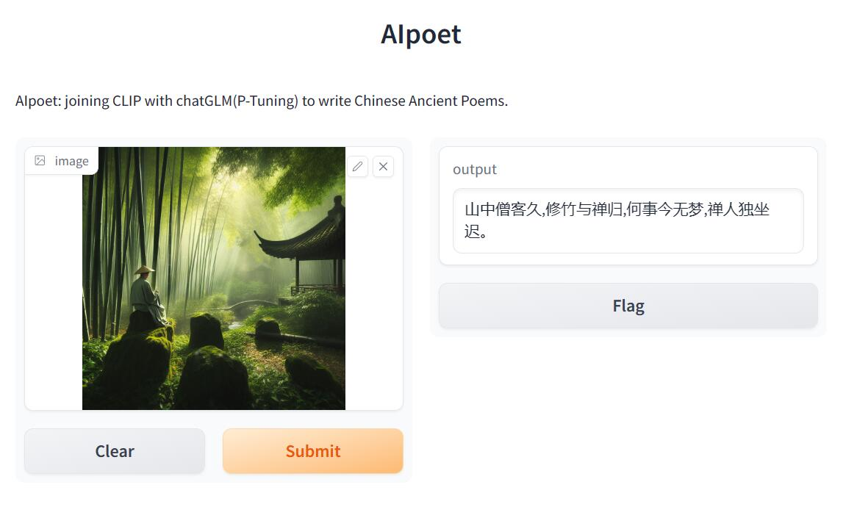
Alpoet
.txt
.pt
Ptuning chatGLM
修竹、僧、禅

Slide 4
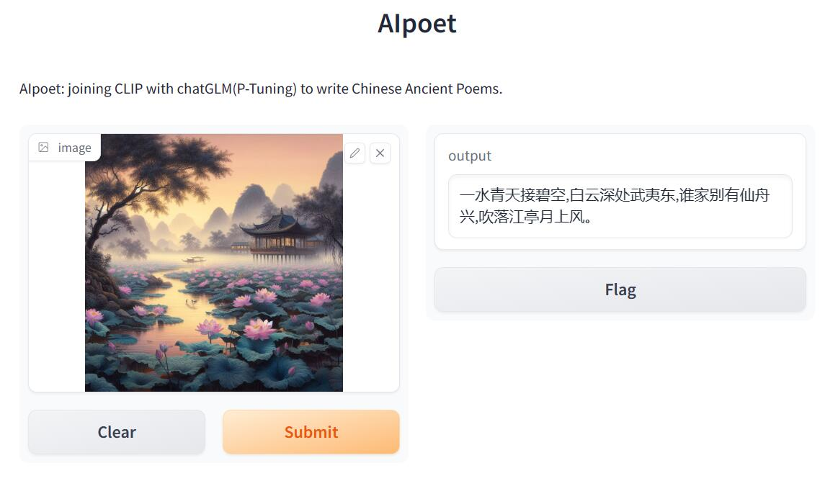
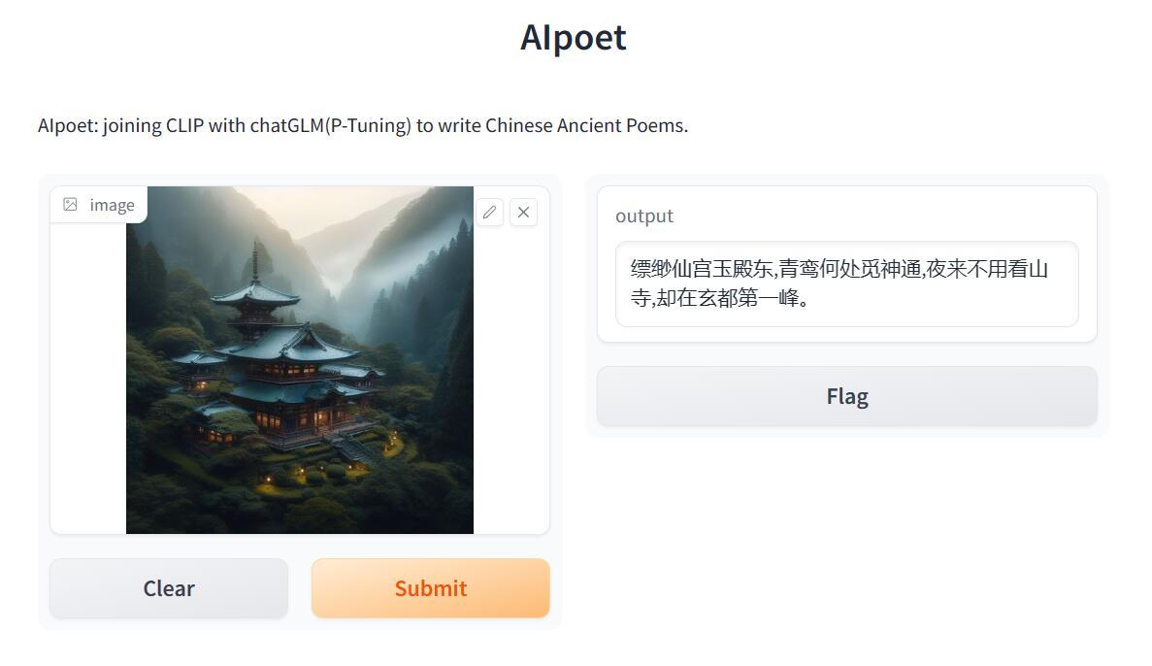
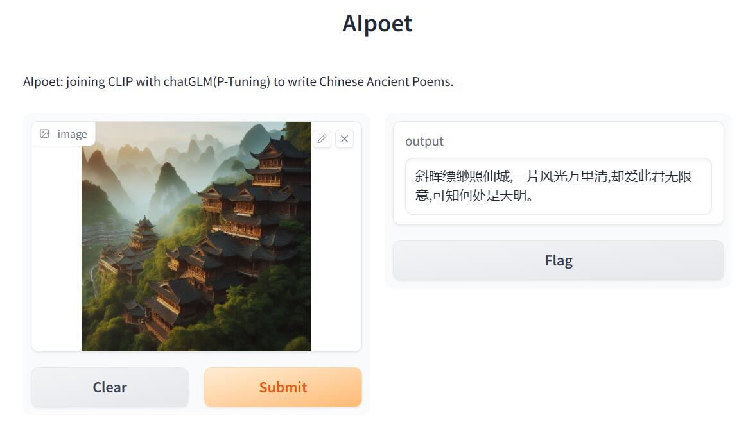
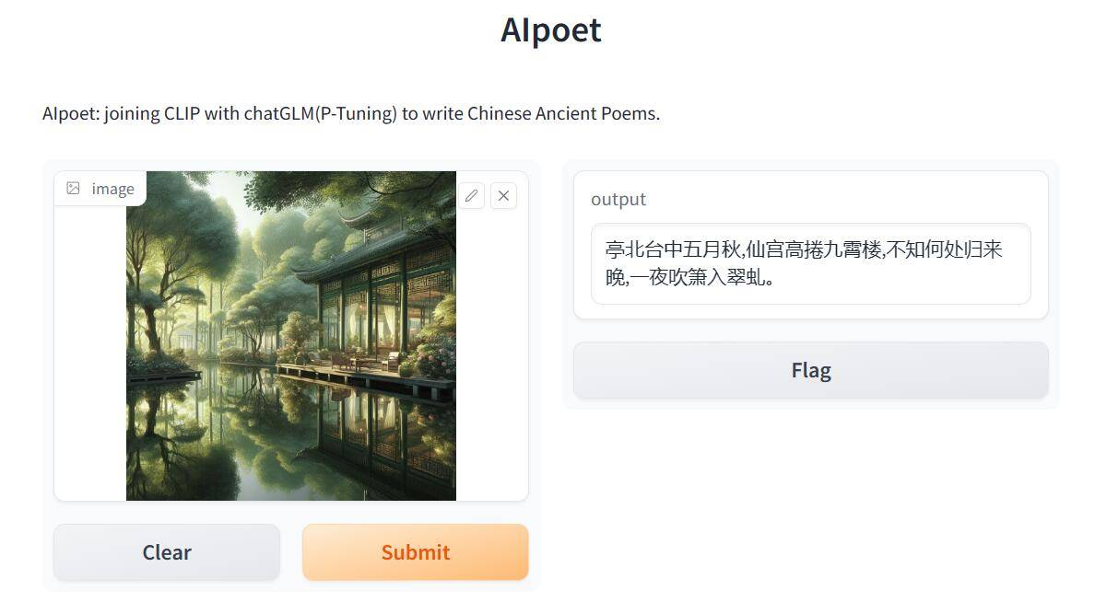
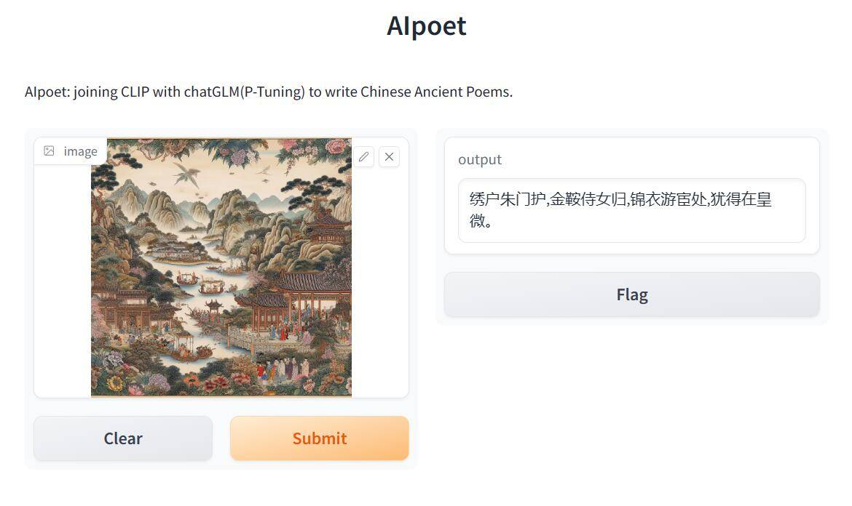
Alpoet

Slide 5
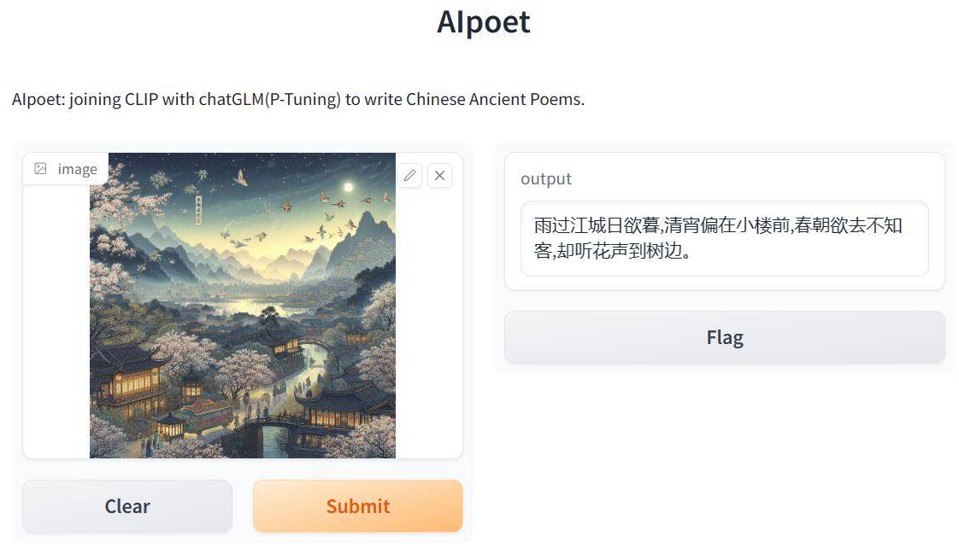
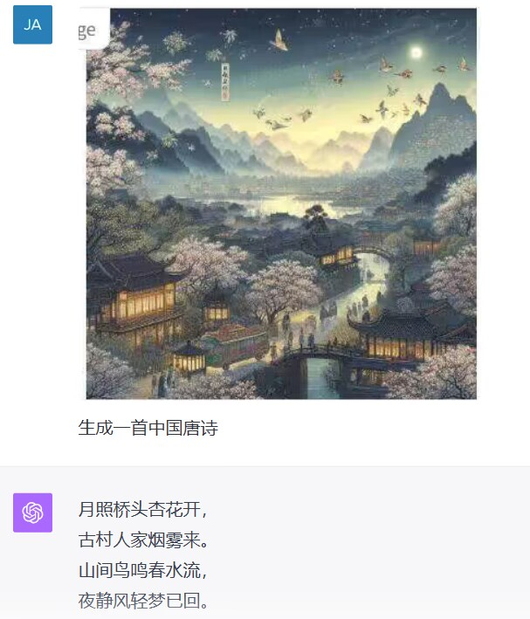
Alpoet
AIpoet
Atmospheric Depiction: The poem meticulously portrays the post-rain cityscape, the impending twilight, and the serene evening by the small pavilion. These vivid imageries provide readers with a striking visual sensation.
Emotional Depth: The phrase "As spring morning departs, unnoticed by its visitors" subtly alludes to the passage of time and the solitude felt by individuals, leaving a profound impression on the reader.
Use of Imagery: The line "Yet, one hears the whisper of blossoms by the tree" employs the metaphor of "whisper of blossoms" to evoke a sense of spring's vitality and vibrancy in the reader's mind.
GPT4
The poetic lines lack a sense of depth and dimensionality.

Slide 6


Alpoet
GPT4-V
VS
Ours
This passage is overly simplistic, lacks depth and emotion, focuses on direct descriptions, and fails to capture the concealed emotions and unique qualities of ancient texts.
瑶琴罢处玉窗春，
曲尽新声又满空。
何用长吟为君说，
不知何处是他乡。
This passage skillfully blends profound emotion with clear logic, seamlessly capturing the essence of classical literature.
绿梧青竹影参差，
碧水静波映楼池。
阳光透破云层雾,
清风送来水边诗。
Suitable for tasks across All domains and scenarios.
Only applicable to the "Seeing AI" single vertical scenario.

Slide 7
Alpoet
CLIP
Training Data:
Relies on text-image pairs for training.
Model Components:
Comprises two models: Text Encoder and Image Encoder.
Training Process:
Combines text and image features in pairs.
Computes cosine similarity to create a similarity matrix.
Positive pairs (N pairs on the diagonal) and negative pairs (N^2-N) are used.
Objective: Maximize similarity for positives, minimize for negatives.
CLIP Overview:
Abbreviation for “Contrastive Language-Image Pre-training.”
Focuses on training visual models using text as a guide.
Known for zero-shot learning and strong generalization.

Slide 8
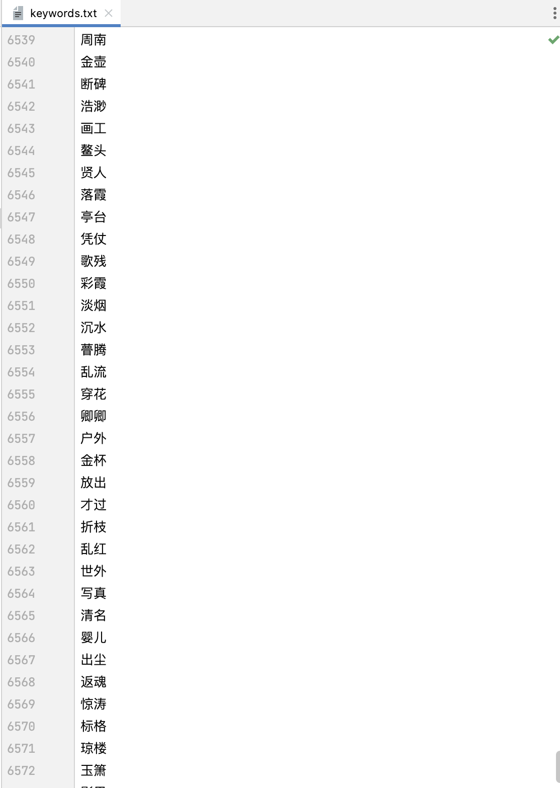
Alpoet
Datasets

Slide 9
Alpoet
Datasets
Foundational dataset: The CCPC dataset from Tsinghua University
specific historical periods
keywords
textual content
Further: A dialogue-based dataset.
{dynasty: 明代，
author: 詹若水，
content: 白石映白心|千仞高上池|悬崖须放手|步步自由情，
title: 答贵阳朱制白石池口清诗二首之一，
keywords: 高，放手，白石，白}.

Slide 10
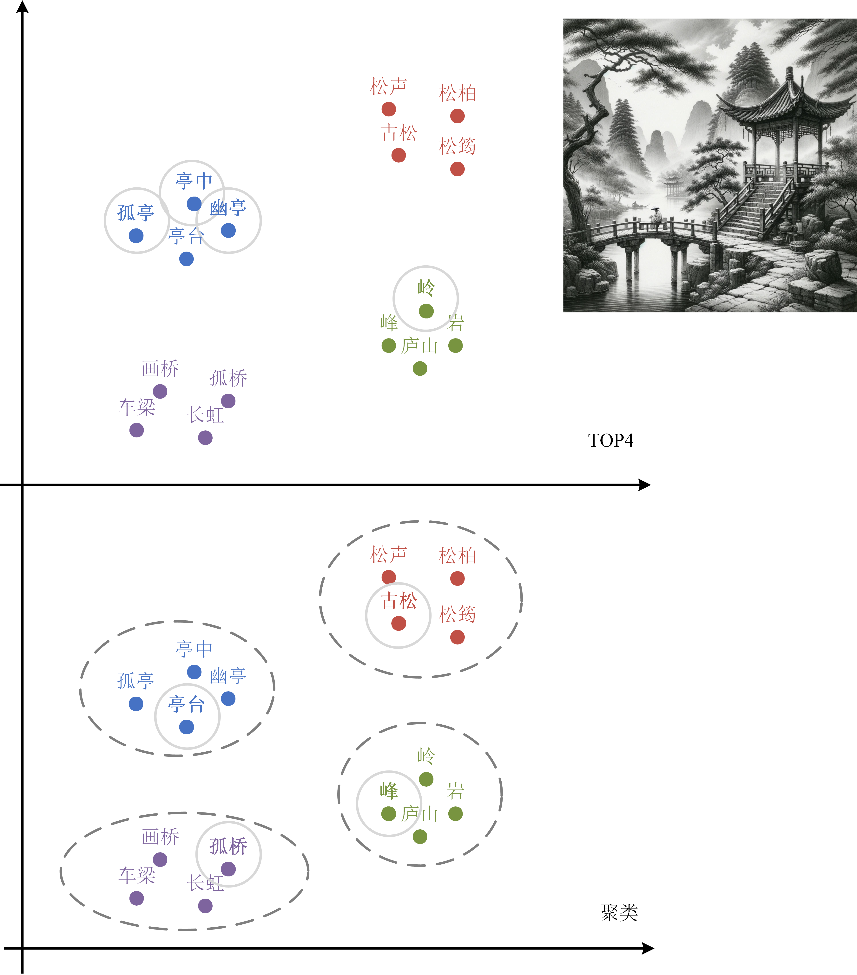
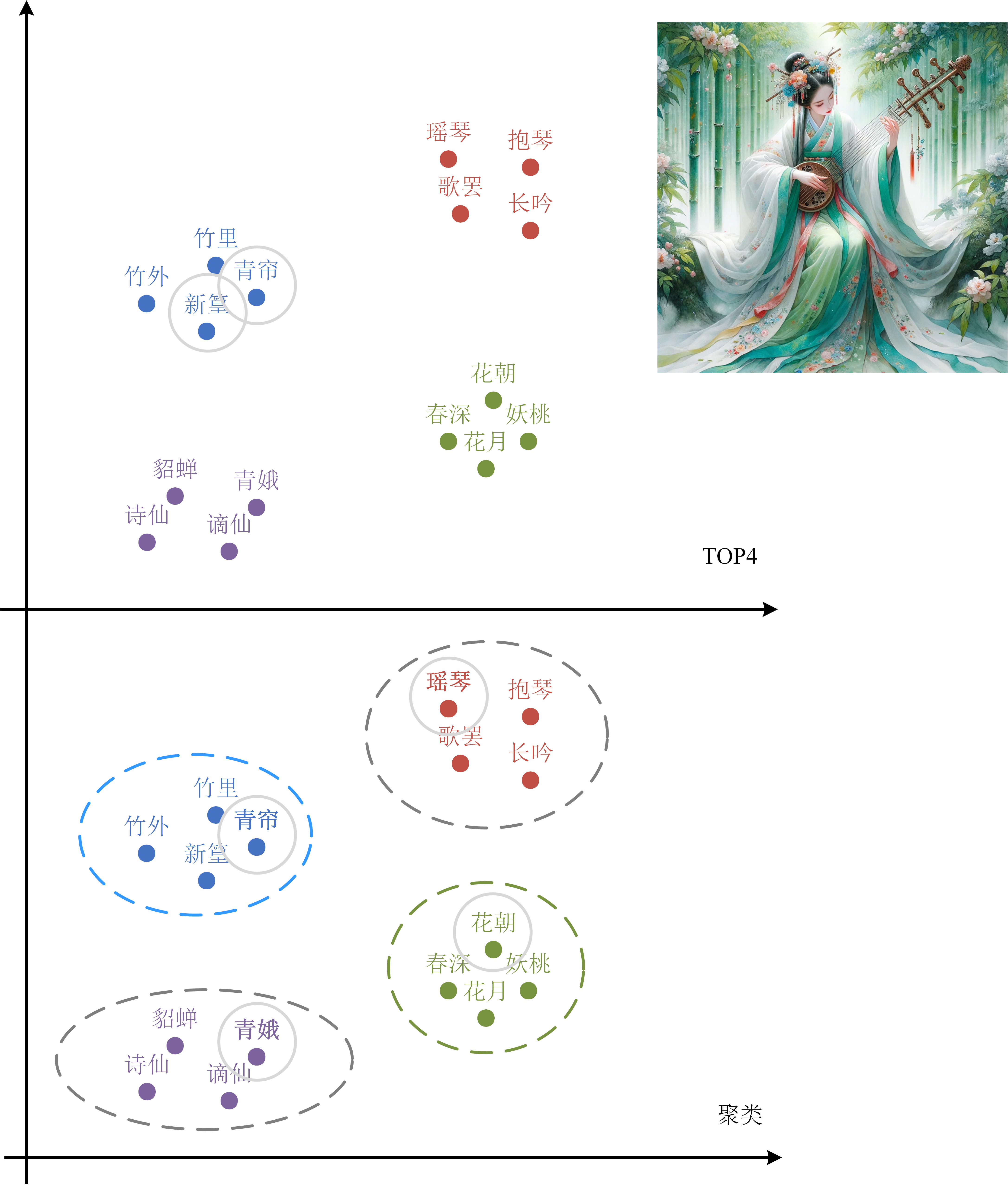
Alpoet
K-Means Clustering Algorithm - Performance results

Slide 11
Alpoet
K-Means Clustering Algorithm
To address the presence of words with similar meanings, the K-Means clustering algorithm is introduced to categorize similar words within CLIP-generated word groups.
Introduction of K-Means Clustering
Model training aims to optimize keyword selection by calculating importance scores, obtaining embeddings, and assessing word similarity using cosine similarity.
Model Training
Cosine Similarity Assessment
Cosine similarity assessment aims to gauge the semantic similarity between words in the generated word groups.
The K-Means clustering algorithm is applied to group similar words together, simplifying subsequent selection operations.
K-Means Clustering
The goal of keyword selection is to choose the most important word from each cluster based on their importance scores.
Keyword Selection
Preprocessing involves removing specific words from the word list to ensure selected words have sufficient importance and differentiation.
Preprocessing

Slide 12
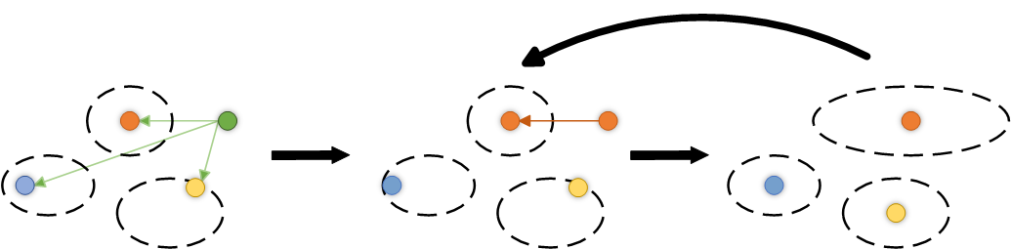
Alpoet
K-Means
Repeat
Step1 Initialization
Choose the number of clusters, K, and randomly select K data points from the dataset as the initial cluster centers.
Step2 Assignment to Nearest Cluster
For each data point, calculate its distance to each cluster center and assign it to the nearest cluster.
Step3 Recompute Cluster Centers
Calculate new cluster centers by taking the average of all data points within each cluster.

Slide 13
Alpoet
ChatGLM
ChatGLM is a powerful natural language processing model based on the General Language Model (GLM) architecture. It incorporates several key algorithmic concepts:
Autoencoding: ChatGLM uses autoencoding to learn useful features from input data by randomly removing continuous tokens, enabling tasks like dimensionality reduction and data reconstruction.
Autoregression: This technique helps the model predict missing tokens sequentially, using both corrupted text and previously predicted spans, making it effective for text generation.
Span Shuffling: To enhance text diversity and fluency, ChatGLM randomly rearranges segments within the text, generating a variety of text variants.
Two-Dimensional Position Encoding: Unlike traditional one-dimensional position encoding, this method provides information about relative word positions, aiding the model in better capturing structural and sequential relationships within the text.

Slide 14
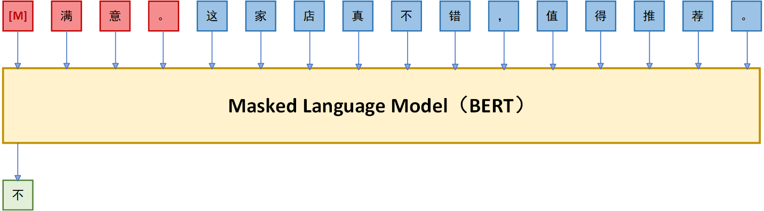
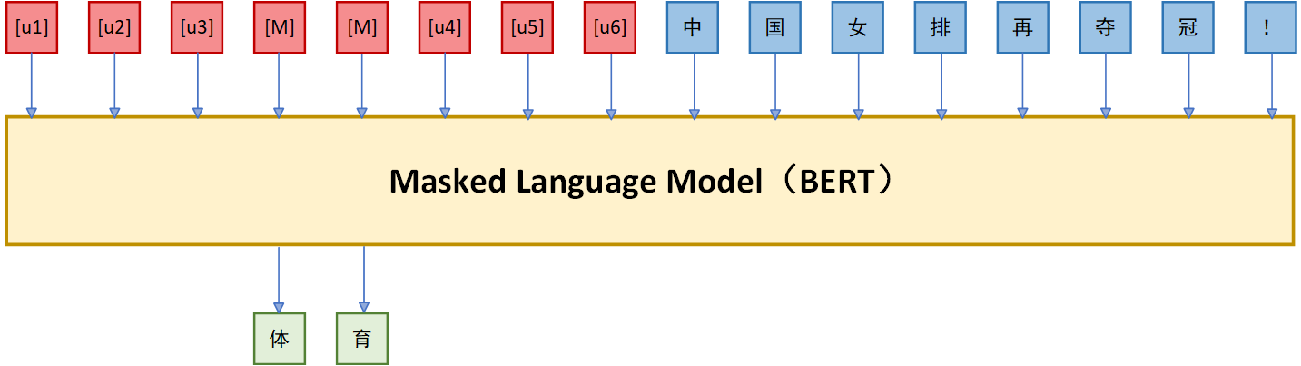
Alpoet
P-Tuning
P-Tuning (Prompt Tuning) is a technique used to fine-tune pretrained language models for specific tasks. Its focus is on improving the model's applicability, enabling it to perform tasks more effectively without the need for costly task-specific training.
Pattern-Exploiting Training
Emphasizes the structure and patterns of the task by designing question templates.
Involves more manual design work as it requires creating question templates for the task.
vs
Prompt Tuning focuses on finding the right prompts to trigger the model to perform specific tasks.
Is more automated and can discover the best prompts through search algorithms.
Prompt Tuning

Slide 15
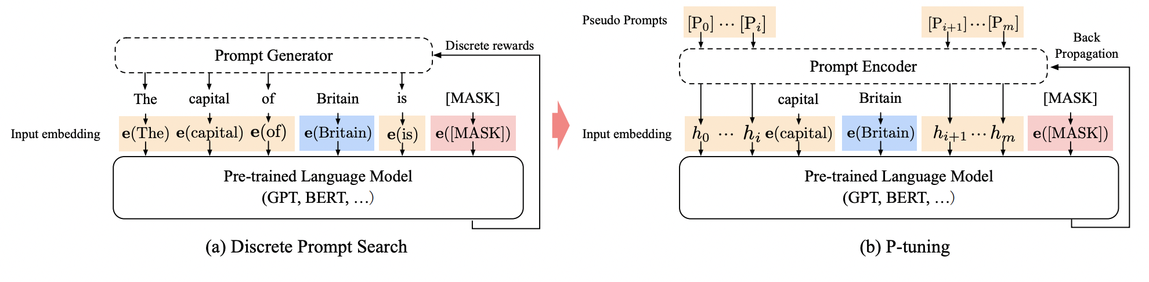
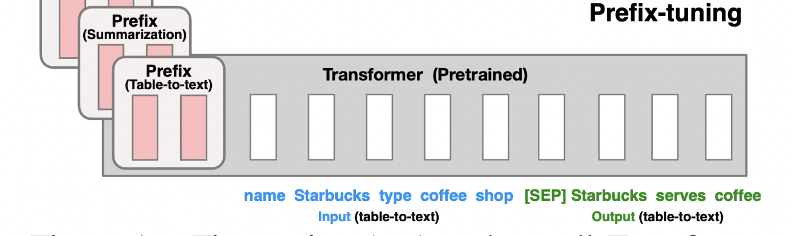

Slide 16
Alpoet
Project Objectives
To enhance the Chat-GLM-6B model through a meticulous fine-tuning process, enabling it to better conform to specific input requisites. Concurrently, our aim is to ensure that the model can sustain both a high level of accuracy and adaptability when processing texts characterized by particular historical, cultural, and linguistic attributes. Through targeted fine-tuning of the model, we anticipate that it will exhibit an improved capacity to precisely comprehend and generate verses pertaining to selected topics.
Environment
Operating System: Ubuntu 20.04 Python Version: 3.8 Deep Learning Framework: PyTorch 2.0.0 GPU: NVIDIA RTX4090 24G CUDA Version: 11.8
In this environment, we conducted fine-tuning of the chat-GLM model. Initially, fine-tuning with 6,000 steps took 7 hours. Subsequently, additional fine-tuning was performed with steps ranging from 3,000 to 20,000, which consumed nearly 30 hours (equivalent to 1.2 days).

Slide 17
Alpoet
Process - 1
In this process of fine tuning, we freeze the CLIP model and only fine tune the chat-GLM-6B model. To better fit the requirements of the model input, we transform the original keyword list with 6804 items into vector form .pt type before inputting the data. In the experiment to fine tune the chat-GLM with 6,000 steps, we initialize the following parameters:
Parameters | Values
max_source_length | 256
max_target_length | 256
gradient_accumulation_steps | 16
max_steps | 3000
learning_rate | 2e-2
pre_seq_len | 128

Slide 18

Alpoet
Process - 2
We use P-Tuning method to fine tune the model by initializing the pre_seq_len at 128.
Fine tuning the chat-GLM model
Combine the fine-tuned chat-GLM and classic CLIP model
Introduce the K-Means clustering algorithm into our model
Select the top k words in some word clusters
CLIP’s similarity comparisons produce repetitive Chinese words with varied expressions. Using CLIP results directly for chat-GLM generation leads to repetitive poetic imagery, lowering artistic and production quality.
Input them to the down-stream chat-GLM model

Slide 19
Alpoet
Why
use two models instead of leveraging existing multimodal image-to-text generation models and fine-tuning them?
The
reason for using two models instead of fine-tuning existing multimodal image-to-text generation models is our access to extensive literary and poetry datasets, which are well-suited for CLIP to compare text and images—a highly
effective approach. However, we do face limitations in terms of direct comparison datasets between images and poetry.
I have
concerns about the CLIP model. CLIP, as a large pre-trained model, only achieves an accuracy of 75.4% on the ImageNet dataset in comparison？
Despite
CLIP's ImageNet accuracy being only 75.4% in Top-1, it excels in multimodal tasks, accurately extracting relevant keywords from thousands of words when comparing text and images due to its strong training in understanding semantic relationships between them through contrastive learning.

